Slide 1


Hearty
Welcome
JAYANATH R
DEPUTY DIRECTOR
Coconut Development Board
Ministry of Agriculture, Govt. of India, Kochi.
STATE CENTRE, HYDERABAD, A.P
www.coconutboard.gov.in
1
1

Slide 2
COCONUT DEVELOPMENT BOARD
VISION
Integrated development of coconut cultivation and industry in the country so as to make the coconut economy sustainable and globally competitive.

Slide 3
MISSION
COCONUT DEVELOPMENT BOARD
To achieve targeted production and productivity in coconut with the help of various State Govts., Departments and other agencies by successful implementation of various projects on Integrated development of coconut gardens, Rejuvenation and Replantation, Technology Mission on Coconut, Export Promotion activities etc.

Slide 4
AREA, PRODUCTION & PRODUCTIVITY OF COCONUT IN AP : 2013-14
SL No | Districts | Area(Ha) | Production (Lakh Nuts) | Productivity (Nuts/Ha)
1 | EAST GODAVARI | 50285 | 7208.95 | 14337
2 | WEST GODAVARI | 21561 | 4489.03 | 20821
3 | SRIKAKULAM | 14480 | 2498.59 | 17256
4 | VISAKAPATANAM | 6796 | 767.21 | 11290
5 | CHITTOOR | 3563 | 198.47 | 5571
6 | VIZIANAGARAM | 2711 | 435.92 | 16080
7 | KRISHNA | 2116 | 340.28 | 16082
8 | NELLORE | 560 | 90.00 | 16072
9 | ANANTAPUR | 717 | 39.69 | 5536
10 | GUNTUR | 114 | 18.40 | 16141
11 | CUDDAPAH | 117 | 6.47 | 5530
12 | PRAKASAM | 40 | 6.46 | 16150
13 | KURNOOL | 11 | 0.58 | 5273
 | TOTAL | 103071 | 16100.05 | 15620

Slide 5
Programmes
CDB Schemes
Production and distribution of planting materials
Expansion of area under coconut
Integrated farming for productivity improvement
Technology demonstration and documentation
Technology Mission on Coconut
Market promotion and statistics
Information & information technology

Slide 6
CDB SCHEMES : 2015-16
Sl.No | Scheme | Year | Target
 |  |  | Phy (Ha) | Fin (Lakhs)
1 | AEP | I | 500.000 | 9.380
 |  | II | 1001.986 | 27.500
 | Sub-total |  | 500.000 | 36.880
2 | LODP | I | 1500.000 | 197.600
 |  | II | 7714.616 | 922.676
 | Sub-total |  | 1500.000 | 1120.276
3 | LODP (through DOH) | I | 325.000 | 56.875
 |  | II | 164.000 | 28.700
4 | Seed Garden |  | 1 unit | 3.000
5 | Coconut Nursery |  | 6 Unit | 6.000
6 | Establishment of Regional Coconut Nurseries (50:50 basis) |  | 0.1 lakh seedlings | 3.200
7 | Organic Manure Unit |  | 10 Units | 4.000
 | TOTAL (Rs in lakhs) |  |  | 1258.926

Slide 7
Production and Distribution of
Planting Material
Objectives :
Large scale production of coconut seedlings to meet the demand of farmers
Components:
Establishment of DSP farms for coconut
Setting up of Coconut Nurseries attached to the DSP farms
Establishment of Regional Coconut nurseries
Aid to Registered/Private/approved coconut nurseries
Production & distribution of hybrids/ other local seedlings

Slide 8
Demonstration cum Seed Production
(DSP) Farms
Mandya (Karnataka) -20 ha (1982)‏
Abhayapuri (Assam) - 40 ha(1987)‏
Madhepura (Bihar) - 40 ha (1987)‏
Kondagaon (Chattisgarh) - 40 h(1988)‏
Neriamangalam (Kerala) - 20 ha (1991)‏
Vegiwada (Andhra Pradesh) - 71.8 ha (1994)‏
Pitapally (Orissa) - 40 ha (1999)‏
Palghar (Maharashtra) - 40 ha (2013)
Dhali (Tamil Nadu) - 40 ha (2014)

Slide 9
Expansion of Area under Coconut
Objective: : To provide incentive subsidy to small/ marginal farmers and thereby increase future production potential.
New Planting subsidy : Rs.6250/- per ha. in two installments.
Eligibility
Minimum : 0.10 ha or 10 seedlings.
Maximum : 4 ha.
Planting density : 150 – 175 / Ha.

Slide 10
Integrated Farming for Productivity Improvement - Coconut Clusters
Objective: To improve the production and productivity of coconut holdings through integrated farming systems, Coconut clusters are formed in 25-50 ha.
Financial assistance: Rs. 35000/- per ha. In two years.
Eligibility : Minimum 0.20 ha and max 1 ha.

Slide 11
Assistance to Organic Manure Units
Objective: To promote organic farming by providing financial assistance for production of organic manure (vermi compost/ coir pith compost)‏
Quantum of assistance : Rs. 60,000/- per unit.
(size -60ftx 8ftx 2.5ft)‏
Eligibility: Individuals/ Societies/ Voluntary organizations, etc.

Slide 12
Farmer Producer Organizations (FPO’s) in Coconut Sector
Board has initiated the formation of Coconut Producer Societies (CPS) by associating 40-100 coconut growers in a contiguous area with a consolidated minimum of 4000-5000 palms
Objective is socio economic upliftment of the farmers through productivity improvement, cost reduction, efficient collective marketing and processing and product diversification
Already 8452 CPS’s/626 CPF’s & 42 CPC’s in a span of three years have been registered with Board.

Slide 13
Coconut Producers Company Ltd (10 lakh yielding palms)
Coconut Producers Society (5000 yielding palms)
Coconut Producers Federation
(1 lakh yielding palms)
Coconut Producers Society (5000 yielding palms)
FPOs Integration
Producer Company registered under section 581 (b) of Indian Companies Act, 1956
Coconut Producer Companies for Positive Transition in Coconut sector

Slide 14
POTENTIAL FOR FPO’S IN AP
Sl No | Districts | Area under Coconut (Ha) | CPS Target | CPS in formation stage | CPS registered with State | CPS-Regd with CDB | CPF-Target | CPF - formation stage | CPF Regd with CDB | CPC- Target | CPC-Regd with CDB
1 | East Godavari | 50285 | 1000 | 527 | 459 | 404 | 60 | 43 | 32 | 6 | 2
2 | West Godavari | 21561 | 425 | 160 | 133 | 121 | 30 | 11 | 7 | 3 | -
3 | Srikakulam | 14480 | 280 | 205 | 110 | 110 | 20 | 10 | 10 | 2 | 1
4 | Vizianagaram | 2711 | 50 | 28 | 18 | 18 | 3 | 3 | 1 | - | -
5 | Vizag | 6796 | 135 | 26 | 16 | 11 | 10 | 2 | - | 1 | -
6 | Chittoor | 3563 | 70 | - | - | - | 5 | - | - | - | -
7 | Krishna | 2116 | 40 | - | - | - | 2 | - | - | - | -
 | Total | 101512 | 2000 | 946 | 736 | 664 | 130 | 69 | 50 | 12 | 3

Slide 15
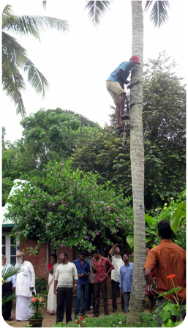
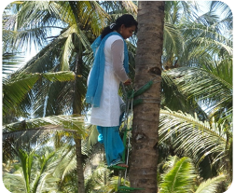
Friends of Coconut Tree (FoCT)
To develop a professional group of youth under the banner “Friends of Coconut Tree” for harvesting and plant protection operations

Slide 16
FOCT objective
To develop a professional group of youth under the banner of FOCT for harvesting and plant protection operations in coconut
To impart training to a group of unemployed youth in developing technical skills, entrepreneurship capacity, leadership qualities and communication skills to address the needs of the coconut growers
Generate appropriate technologies to support sustainable growth of coconut sector and generate employment opportunities for the youth
To make them self reliant and instill confidence in undertaking the responsibility
To tackle the problem of unavailability of coconut tree climbers for coconut farming and plant protection activities

Slide 17
FOCT Selection Criteria
Age group of 18-40 yrs
Free from any disability
Minimum education up to 7th standard
6 days residential training programme
Preferably underemployed healthy individuals
Minimum of 30% of trainees to be women

Slide 18
Friends of Coconut Tree
Over the years….
YEAR | No of FOCT’s
2012-13 | 160
2013-14 | 260
2014-15 | 265
2015-16* | 20
Total | 705
* 2 CPC’s to start FoCT training at Srikakulam and East Godavari. Schedule finalized for 6 batches during Nov-Dec by KVK’s and HRS, Ambajipeta

Slide 19
CDB as Export Promotion Council
Coconut Development Board has been notified as Export Promotion Council on 1.4.2009
So far 1800 exporters of coconut and coconut products have registered with the Board.
Extending all GOI benefits to exporters of coconut products. (VKGUY, FPS, DDB)
Single Window facilitation

Slide 20
Coconut Palm Insurance Scheme
To minimize farmers risk
  Palm insured against pest and disease and natural calamities
 | Board’s share (50%) | State Govt.’s share (25%) | Farmers share (25%) | Premium per palm | Sum insured per palm
Mature yielding palms | Rs.7.00 | Rs.3.50 | Rs.3.50 | Rs.14.00 | Rs.1750

Slide 21
Kera Suraksha Insurance Scheme
for Coconut Tree Climbers
  To minimize risk of the climbers
  To make available climbers for harvesting
Kera Suraksha Insurance Scheme for Coconut Tree Climbers | Annual premium per Climber | Board’s share of premium (75%) | Beneficiary’s share of premium (25%) | Sum insured
 | Rs.66 | Rs.49 | Rs.17 | Rs 2 lakh

Slide 22
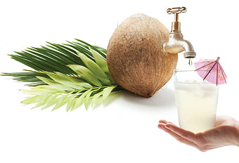
COCONUT PRODUCTS
PROCESS & PROJECT COST
COCONUT DEVELOPMENT BOARD
STATE CENTRE, HYDERABAD

Slide 23
A Versatile Crop-often known as Kalpavriksha- ‘TheTree of life’
Used as – edible crop, oilseed crop, fibre crop, medicinal &beverage crop
for roof and fencing
inevitable item in cultural and social use, culinary item
As building materials, flooring materials and handicrafts
for industrial products, handicraft items
yield coconut neera

Slide 24
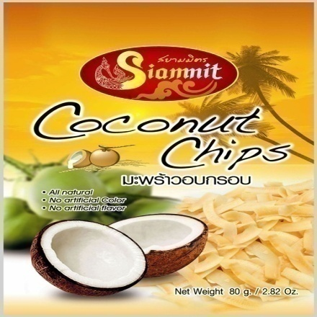
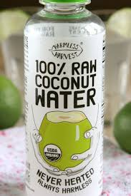
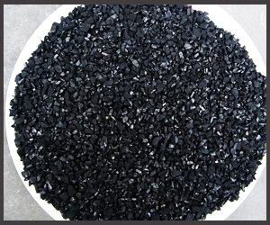
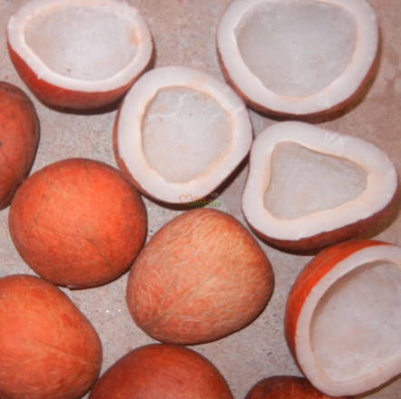

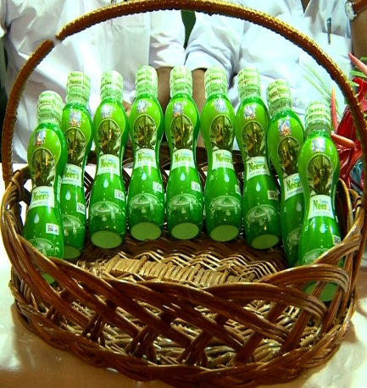
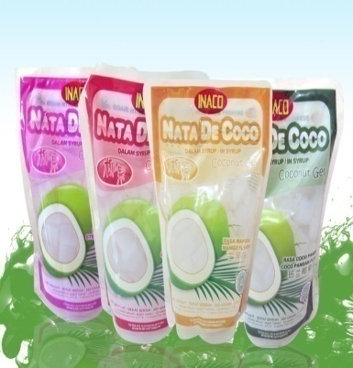
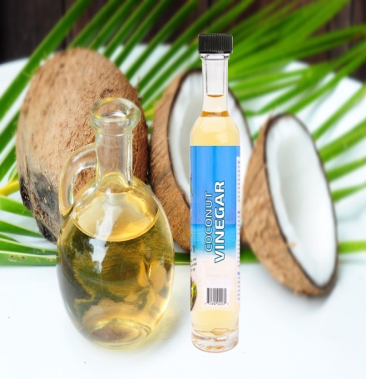

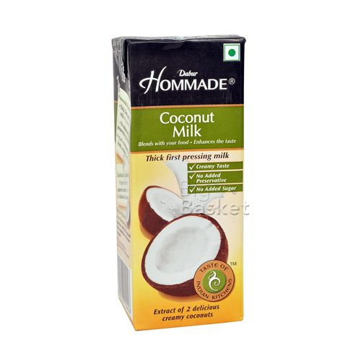
COCONUT PRODUCTS

Slide 25
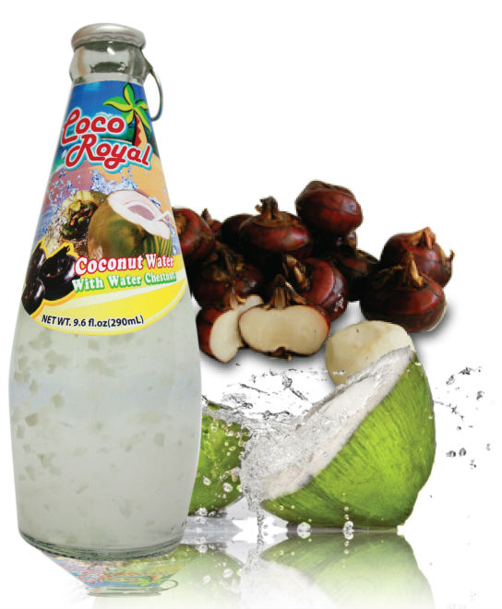
Tender COCONUT WATER
The water of tender coconut, technically the liquid endosperm, is the most nutritious wholesome beverage that the nature has provided for the people of the tropics to fight the sultry heat.

Slide 26
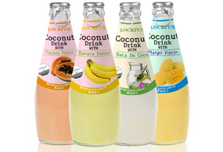
Process
Extract coconut water (6-7 month) using a vacuum suction device
Filter through pressure filters
Mix with the desired proportion of additives plus sugar and concentrate to the appropriate level.
Pack the water in pouches/cans and retort in an autoclave
Cool in a stream of cold water

Slide 27
Project cost (10,000 nuts per day)
Land (cost variable) | 60 cents
Building -3000 sq ft | Rs.48 lakhs
Plant & machinery | Rs. 40 lakhs
Electrification works | Rs.10 lakhs
Preliminary & pre - operative expenses | Rs. 05 lakhs
Working capital(Margin money) | Rs. 15 lakhs
Total | Rs.118 lakhs

Slide 28
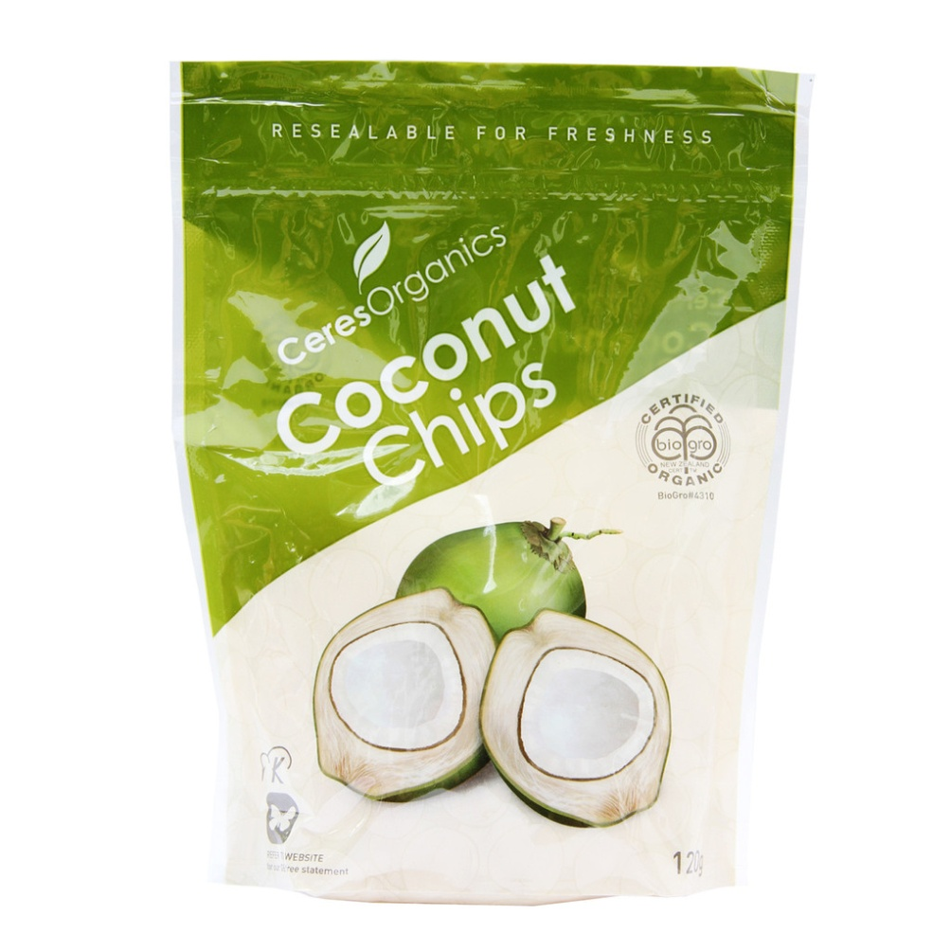
COCONUT CHIPS
Crunchy, delicious nutritionally rich chips

Slide 29
Why we need alternate snack foods??
Widely consumed snack foods are high in refined carbohydrates or added sugar and low in nutritional value.
Consuming too many refined or sugar rich foods may contribute to inflammation and oxidative stress.
Potato chips and French fries contain 39-910 times higher level of acrylamide.
Coconut chips : Alternative health promoting snack foods which is devoid of frying

Slide 30
Coconut Kernel
Potent source of carbohydrate
Rich source of plant protein
Appreciable amount of fiber
Low in digestible carbohydrate
Contains no gluten
Loaded with health promoting fibre and important nutrients

Slide 31
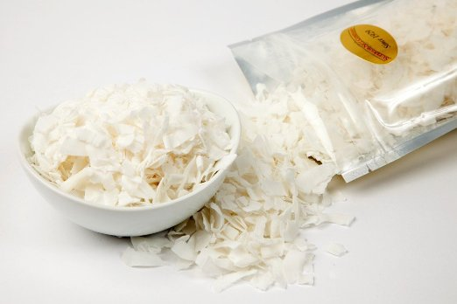
Process
Mature Coconut (8-9 month)
Removal of husk
Cut into Halves
Removal of Shell
Removal of Testa
Washing in Clean Water
Slicing of the Kernal (<0.75mm thickness)
Washing in Clean Water
Blanching (90-95ºC for 2 min)
Osmotic Dehydration (1 hour)
Drying (70-80ºC for 5-6 hrs)
Coconut chips
packing

Slide 32
PROJECT COST (100 KGS PER DAY)
Building 1000 sq ft | Rs.12.00 lakhs
Machinery | Rs.3.50 lakhs
Electrification | Rs.1.00 lakhs
Pre Operative Expenses | Rs.0.50 lakhs
Working capital (Margin money) | Rs.1.00 lakhs
Total | Rs.18.00 lakhs

Slide 33
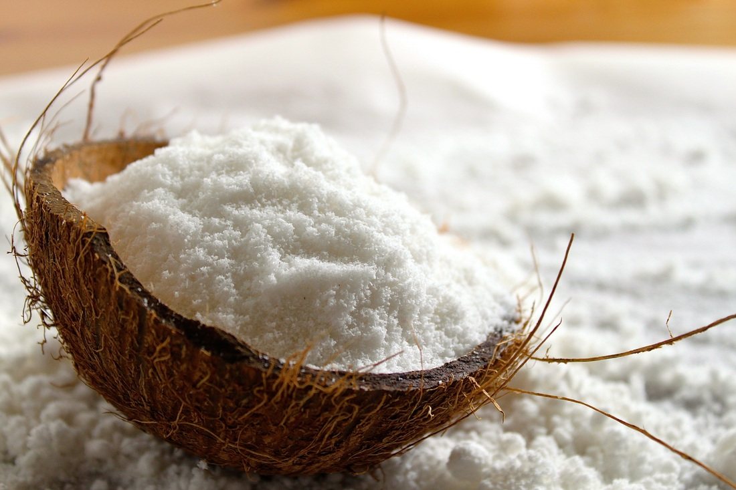
Desiccated Coconut

Slide 34
Process
Dehusk and deshell the fresh matured coconuts
The deshelled coconut kernels in the form of round balls are pared using scrapers to remove the testa
The kernel is then ground into a fine mass using hammer or pin mills.
Blanch with live steam for about 20 minutes to bring down the microbiological counts.
The pared kernel balls are then cut open to drain off the water and then washed thoroughly in fresh water to remove the invert sugars from the inner surface of the kernel.

Slide 35
Dry it in hot air drier at a temperature of 80-90ºC for about 10 hours so as to bring down the moisture content to below 3 per cent.
The hot air drier is provided with a drying chamber consisting of a series of trays, which hold the feed.
Hot air is blown into this chamber from an external source through blowers.
The dried mass is tested for moisture, free fatty acid and microbiological counts.
The product is packed in polythene pouches.

Slide 36
Project Cost (OneTonne/Day capacity)
Land (cost variable) | 50 cents
Building 2000 sq. ft. | Rs.32.00 lakhs (Process Area)
Plant & Machinery | Rs. 25.00 lakhs
Preliminary and pre-operative expenses | Rs. 5.00 lakh
Electrification | Rs. 5.00 lakhs
Working capital (Margin Money) | Rs.10.00 lakhs
Total | Rs. 77.00 lakhs

Slide 37
Coconut Cream

Slide 38
Process
Break the dehusked nuts into halves.
The split nuts are deshelled to separate the kernel.
Wash the Kernel and then blanch it by immersing in hot water at 80ºC for 10 minutes.
Comminution of kernel into small gratings using a hammer mill.
The gratings are subjected to pressing using, continuous screw press to extract the milk.
The coconut milk thus obtained is filtered by passing through a vibrating screen.
Food additives such as emulsifiers and stabilizers, are to be added to the milk to obtain a stable consistency and texture.
For this purpose, permitted emulsifiers and stabilizers are mixed with hot water separately and mixed thoroughly.
This is added to the coconut milk and then subjected to emulsification using a mechanical impeller emulsifier.

Slide 39
The emulsified milk assumes a creamy consistency. The coconut cream is then pasteurized at 95ºC for 10 minutes in a plate heat exchanger
The pasteurized coconut cream is hot filled in cans using a mechanical volumetric filling machine followed by steam exhausting.
The cans are seamed using an automatic can seamer. The seamed cans are sterilized in a rotary retort at 15 psi for 20 minutes
The cans are then cooled in running water
The residue obtained after the extraction of milk is dried in a hot air dryer to 3 per cent moisture level.
The residue forms a base for making coconut burfi, coconut cookies, curry and chutney powders
Other by-products like coconut water and coconut shell could be processed into value added products.
Vinegar and Nata-de-coco can be manufactured from coconut water. Shell charcoal and shell powder can be manufactured from coconut shells.
The utilization of byproducts would improve the economic feasibility of the process.

Slide 40
Project Cost (10,000 nuts/day)
Land (cost variable) | 1 acre
Building-4000 sq ft | Rs.64.00 lakhs
Plant & machinery | Rs.60.00 lakhs
Preliminary and pre-operative expenses | Rs.05.00 lakhs
Electrification | Rs.15.00 lakhs
Working capital (Margin money) | Rs.15.00 lakhs
Total | Rs. 159.00 lakhs

Slide 41
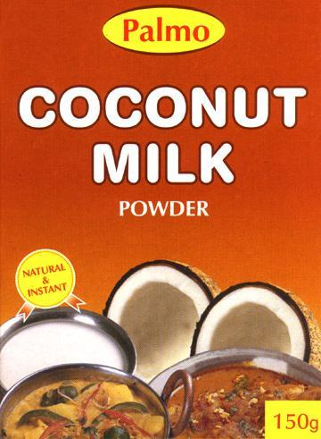
Spray Dried Coconut Milk Powder

Slide 42
Process
Undergone five major processing steps:
  Extraction
  White coconut meat, after removal of shell and paring, is passed through a rotary wedge cutter; the grated coconut meat is pressed in a screw press to extract the coconut milk.
  Formulation
  The coconut milk is formulated by addition of 8-10 % maltodextrin as carrier.
  Pasteurization
  Homogenization
  Spray drying

Slide 43
Project Cost
(Capacity 20,000 nuts/day.)
Land | 1 acre
Building-8000 sq ft | Rs. 60 lakhs
Plant & machinery | Rs. 175 lakhs
Electrification | Rs. 30 lakhs
Preliminary & pre-operative expenses | Rs. 25 lakhs
Working capital (Margin money) | Rs. 40 lakhs
Total | Rs. 330.00lakhs

Slide 44
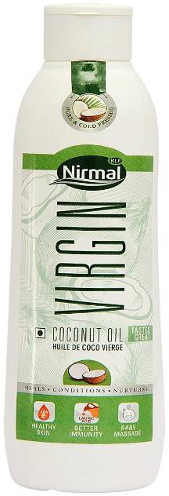
VIRGIN COCONUT OIL

Slide 45
Process
Coconuts are deshelled followed by paring
Disintegrate by passing through a hammer mill/Disintegrator where shredded coconut gratings are forced out
Press it in a screw/hydraulic press to extract fresh coconut milk
The coconut milk is filtered and passed through a high speed centrifuge wherein the coconut oil gets separated from the coconut milk.
The coconut oil is then packed in consumer packs in an automatic packing machine.

Slide 46
Project cost (15000 coconuts per day)
Land | 40 cents
Building -3000 sq ft (Process Area) | Rs. 48 lakhs
Plant & machinery | Rs. 45 lakhs
Electrification works | Rs. 10 lakhs
Preliminary & pre - operative expenses | Rs. 05 lakhs
Working capital(Margin money) | Rs. 10 lakhs
Total | Rs. 118 lakhs

Slide 47
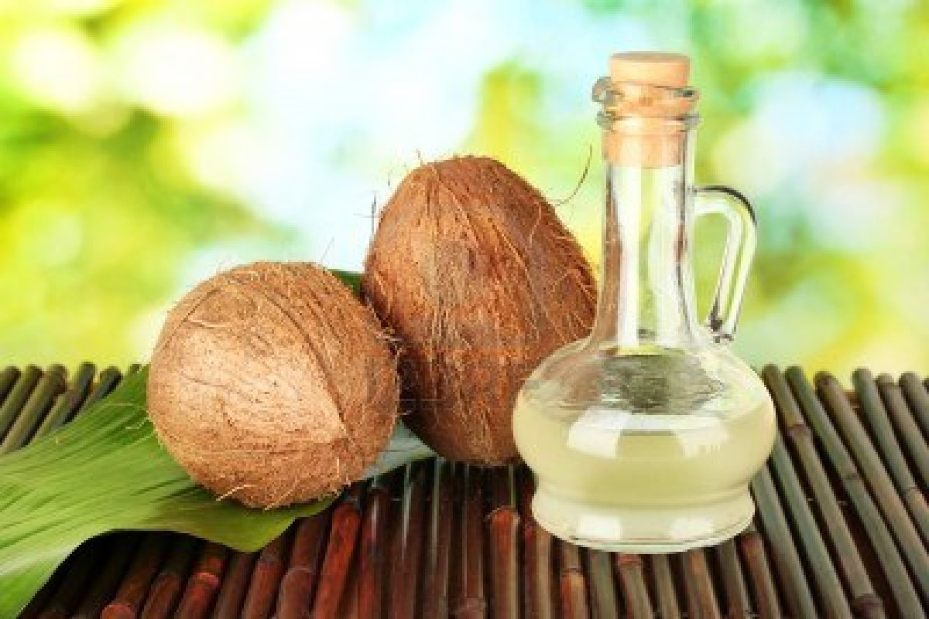
Coconut Oil

Slide 48
Process
Well dried copra with a moisture content not exceeding 6 per cent is cleaned well from any foreign matter.
It is then cut into small chips in a copra cutter.
The chips are fed into steam jacketed kettles and cooked mildly at a temperature of 70oC for 30 minutes.
After proper cooking, the cooked material is fed into the expeller continuously and pressed twice.

Slide 49
The combined oil from the first and the second pressing is collected in a tank provided separately
This oil is filtered by means of a filter press and stored in MS tanks.
Bulk packaging is done in tin containers. HDPE containers and polymeric nylon barrier pouches are used for small consumer packing
The oil cake obtained as a by-product will find a ready market as a cattle feed and in the manufacture of mixed cattle feeds or as a raw material for the extraction of remaining oil by solvent extraction method.

Slide 50
Project Cost
(3 tonnes/day capacity)
Land (cost variable) | 30 cents
Building 2000 sq.ft. | Rs 32.00 lakhs
Plant and Machinery | Rs.20.00 lakhs
Preliminary and preparative expenses | Rs. 5.00 lakhs
Electrification | Rs 5.00 lakhs
Working capital (Margin Money) | Rs.10.00 lakhs
Total | Rs. 72.00 lakhs

Slide 51
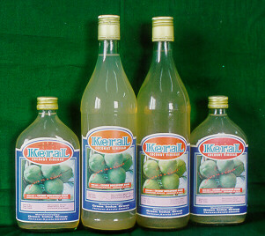
Coconut Vinegar

Slide 52

Coconut Vinegar
The matured coconut water consisting of about 3 per cent sugar content is concentrated to 10 per cent level by fortifying with sugar.
The fortified coconut water is then fermented by inoculating the solution with yeast, Sacharomyces cerviseae.
After alcoholic fermentation for about 4 to 5 days, the clear liquid is siphoned off and inoculated with mother vinegar containing acetobacter bacteria.

Slide 53
The alcoholic ferment obtained is then fed into a vinegar generator where the feed is uniformly sprayed over the surface of the porous packing medium
Here the alcoholic ferment is oxidised to acetic acid.
The product is run out from the packing medium by gravity flow into the receiving vat from where it is recycled into the vinegar generator and the process of acetification is repeated until a strength of 4 per cent is attained.
This acetified vinegar is then aged before bottling.

Slide 54
Project Cost (500 litres/day)
Land | 25 cents
Building - 1500 sq.ft.) | Rs.24.00 lakhs
Plant & Machinery | Rs. 4.00 lakhs
Preliminary & pre-operative expenses | Rs. 2.00 lakhs
Working capital (Margin money) | Rs. 1.00 lakh
Total | Rs. 31.00 lakhs

Slide 55
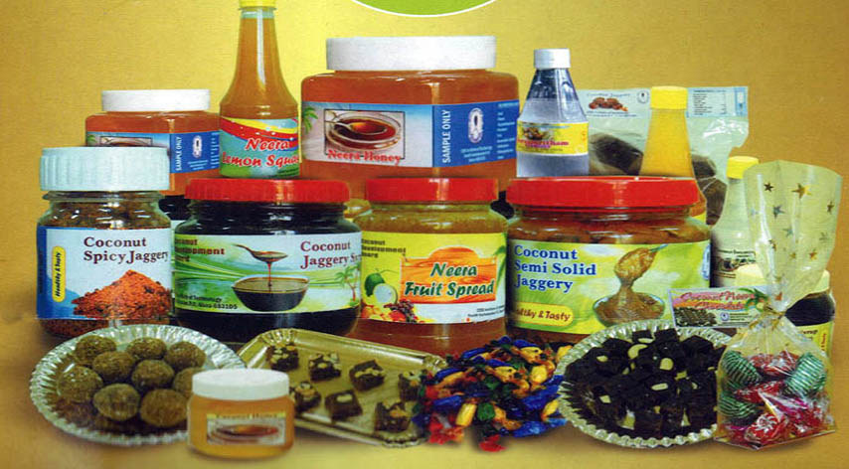
Neera

Slide 56
A sweet sap obtained by tapping unopened inflorescence
A natural, nutritious health drink with medicinal properties.
Natural product, cannot be manufactured in factories.
Huge prospects through its value addition

Slide 57
Conducted awareness meetings with the involvement of FPO’s in EG & WG Districts
State Govt. already announced the willingness for amending the excise act for permitting Neera tapping in the state.
The proposal for Master Neera Tech Training from M/s Noveeal CPC has been submitted.
The CPC in EG Dist. submitted representation before the Govt. of AP for permitting the FPO’s for extracting Neera.
The State is in the process of constituting a high level committee for visiting CDB, Kochi and the CPC’s in Kerala. The visit is tentatively scheduled during the first fortnight of October 2015.

Slide 58

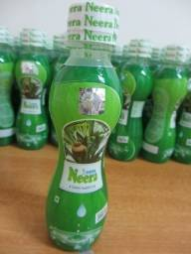
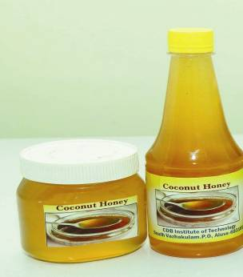
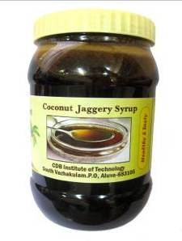
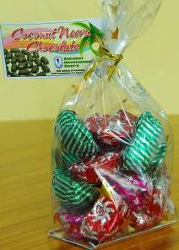
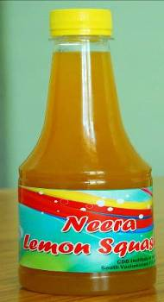
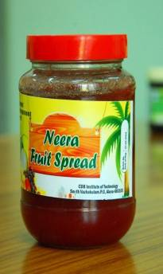
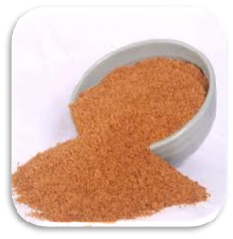
NEERA & ITS VALUE ADDED PRODUCTS
Packed Neera
Neera Syrup
Neera Honey
Neera Syrup Jaggery
Neera Chocolates
Neera Squash
Neera Fruit Spread
Neera Palm Sugar

Slide 59
TECHNOLOGIES FOR TAPPING, PROCESSING & PRESERVATION OF COCONUT NEERA
  CDB Institute of Technology (CIT) under Coconut Development Board, Govt. of India
  SCMS Institute of Science and Technology
  Defence Food Research Laboratory (DFRL)
  Kerala Agricultural University (KAU)
  Central Plantation Crops Research Institute (CPCRI).
  Central Food Technological Research Institute (CFTRI)

Slide 60
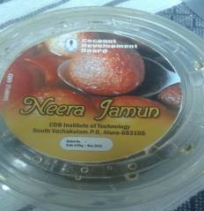
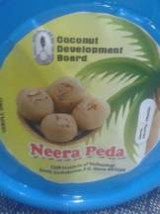
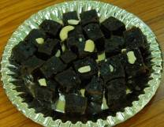
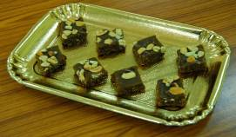
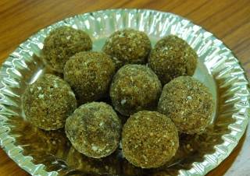
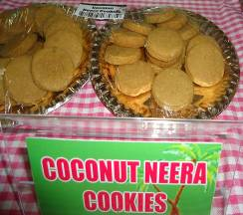
Neera Jamun
Neera Peda
Neera halwa
Neera Laddoos
Neera Cookies

Slide 61
Capital cost for building new plant
Building (cold storage, pasteurisation unit, palm sugar and jaggery production units, effluent treatment plant) | Rs. 125.00 lakhs
Equipments ( filter, quick chiller, centrifuges, packing machine, measurement instruments etc.) | Rs. 98.00 lakhs
Storage tanks | Rs. 10.00 lakhs
Refrigerated boxes and vehicles | Rs. 20.00 lakhs
Laboratory Equipments | Rs. 20.00 lakhs
Miscellaneous (Diesel generator, installation, labour, design consulting service, project supervision etc.) | Rs. 65.00 lakhs
Total | Rs. 338.00 lakhs

Slide 62
NEERA TECHNICIANS
INNOVATIVE GREEN COLLAR JOB
Essential skills to be imparted
Tapping skill
Maintaining hygiene during the collection process
Personal hygiene
Careful handling of Neera till it reaches the processing unit

Slide 63
ECONOMIC POTENTIAL OF COCONUT NEERA – ANDHRA PRADESH
No. of palms tapped for neera |  | Volume of neera from 300 days of tapping (MT) | Income from neera (in crores) | Income to farmers (in crores) | Income to neera technicians (in crores) | Tax revenue earned by government due to increase in purchasing power of neera technicians (in crores)
Percentage of total palms available in the state | Number of palms
1% | 160000 | 48000 | 480 | 240 | 120 | 35
5% | 800000 | 240000 | 2400 | 1200 | 600 | 180
10% | 1600000 | 480000 | 4800 | 2400 | 1200 | 360

Slide 64
ASSUMPTIONS...
Assumptions:
  Minimum 1 litre of Neera is produced per day from a palm
  Neera is produced for 300 days from a palm in a year
  The price of Neera including processing costs is taken as Rs. 100 per litre( Marketing costs extra)
  The coconut farmer is paid Rs. 50/- per litre of Neera produced
  The Neera technician is paid Rs. 25/- per litre of Neera produced

Slide 65
POTENTIAL INCOME TO NEERA TECHNICIANS
 | Yield per palm/day (litres)
 | 1.5 | 2 | 2.5 | 3 | 3.5 | 4
No. of palms tapped | Monthly income earned by a technician (Rs)
10 | 11580 | 13380 | 15180 | 16980 | 19980 | 22980
12 | 12660 | 14820 | 16980 | 20580 | 24180 | 27780
15 | 14280 | 16980 | 21480 | 25980 | 30480 | 34980
18 | 15900 | 20580 | 25980 | 31380 | 37230 | 43980
Assumptions
Neera technician tapping at least 10 palms per day will get Rs 350/- per day irrespective of yield.
Yield above 12 litres per day will fetch them an incentive of Rs 12/- for every additional litre of Neera, up to 30 litres.
Yield above 30 litres per day will fetch them an incentive of Rs 20/- for every additional litre of Neera, upto 60 litres.
Yield above 60 litres per day will fetch them an incentive of Rs 25/- for every additional litre of Neera.
A neera technician has more than 50% chance to earn more than
Rs 20,000/- a month.

Slide 66
NEERA TECHNICIANS-
THE NEED IN ANDHRA PRADESH
Palms tapped |  | No. of technicians required
Percentage % | Number (lakhs)
1 | 1.6 | 8000
5 | 8.0 | 40000
10 | 16.0 | 80000
Assumption :
A Neera technician can tap a maximum of 20 palms per day

Slide 67
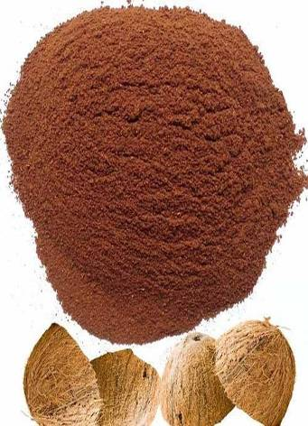
Coconut Shell Powder

Slide 68
Process
The shell powder is then fed into a vibrating sieving machine and packed according to mesh size requirements for various end uses.
The rejects from the sieving machine can be recycled in the pulverizer for size reduction.
The main requirements for consistent good quality of coconut shell powder, are proper selection of shell of proper stage of maturity and efficient machinery.
The powder from the pulveriser is fed into a cyclone and the parallel product is collected in bag filters.
Coconut shells free from contamination of coir pith are broken into small pieces and fed into a pulveriser.

Slide 69
Project Cost (One tonne/day capacity)
Land require (cost variable) | 40 cents
Building (2000 sq. ft.) | Rs. 10.00 lakhs
Plant and Machinery | Rs. 25.00 lakhs
Preliminary & pre-oper expenses | Rs. 5.00 lakhs
Electrification works | Rs. 10.00 llakhs
Working capital (Margin Money) | Rs. 10.00 lakhs
Total | Rs. 60.00 lakhs
IRR | 18%

Slide 70
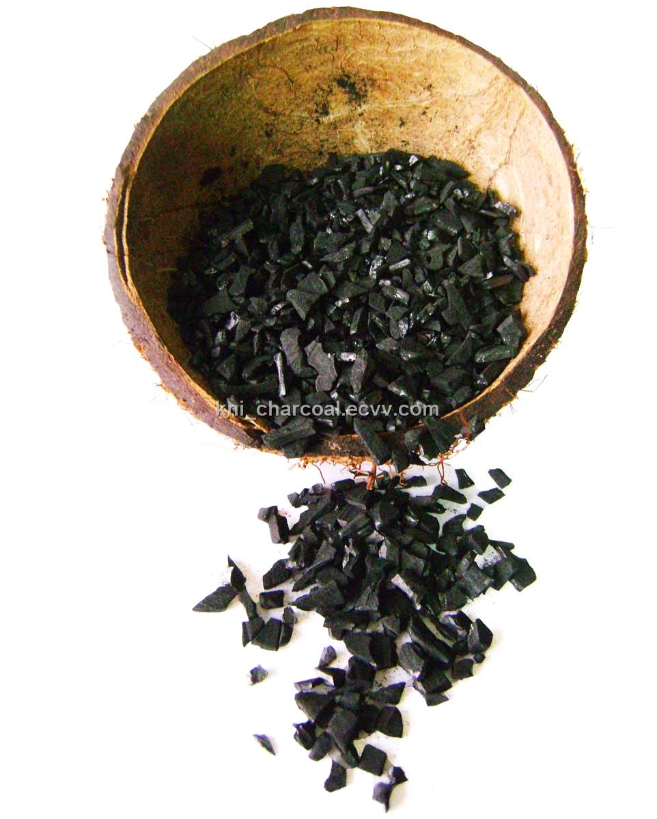
Coconut Shell Charcoal

Slide 71

Process (Drum Method)
A detachable chimney is provided which is installed on the lid after closing the drum.
The manufacture of charcoal requires optimum carbonization of raw shells in a limited supply of air so that there is neither unburnt shell nor ash due to complete combustion.
The steel drum is filled with raw shells after placing temporarily a four inch diameter wooden pole in the centre of the drum.
The wooden pole is then removed, leaving a hollow space in the centre which allows the flow of smoke during carbonization.

Slide 72
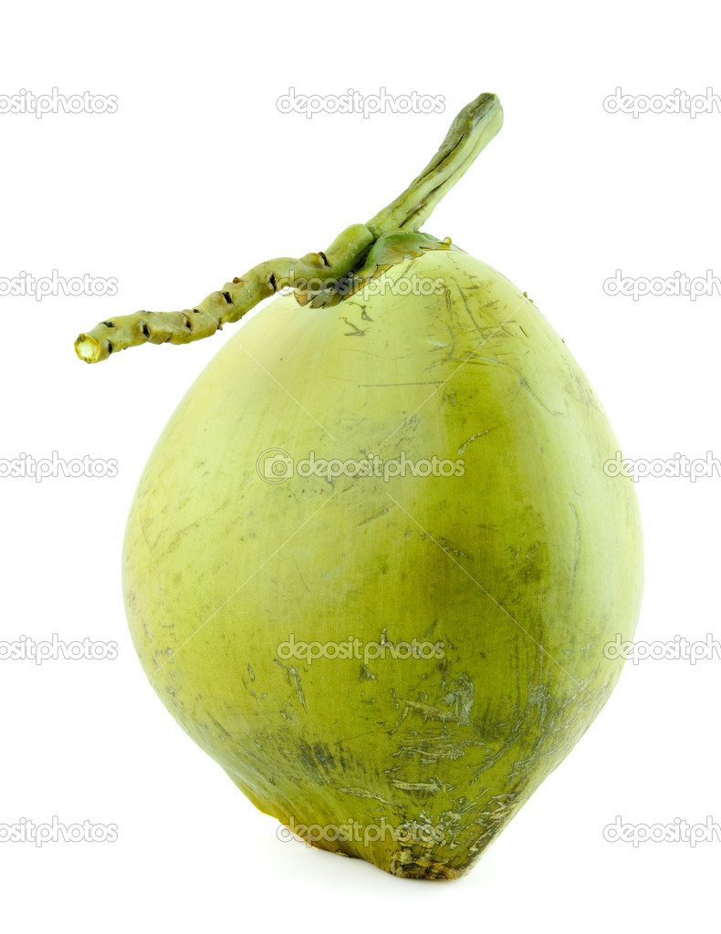
To start carbonization, a piece of burning rag is dropped to the bottom of the drum through the hollow space in the centre.
When the fire is well underway, the lid with the chimney is placed into position and the upper and the middle sets of holes are closed.
Carbonization which starts at the bottom progresses as it goes up as well as radially from the hollow space.
When carbonization is complete in a particular zone, a persistent glow can be seen in all the six holes of a set.
When the bottom most set of holes indicate this situation, the middle set of holes is opened and the bottom set closed.

Slide 73
The stoppage of air flowing into the bottom region avoids over-carbonization in that region.
The progressive carbonization results in reduction in volume of contents and therefore more shells are added from the top.
When the middle region is carbonized well, the top set of holes is opened while the middle set is now closed.
A further addition of raw shells is done to fill the volume reduction to maximise capacity for burning.
When the top region is well carbonized, the top set of holes is also closed, resulting in complete stoppage of air inflow to the drum.
The drum is then cooled for about eight hours after which the product is ready for discharge.

Slide 74
Project Cost (one tonne/day)
Land (cost variable) | 35 cents
Building 1000 sq. ft. | Rs. 4.00 lakhs
Plant machinery | Rs. 18 lakhs
Preliminary & pre-operative expenses | Rs.2.0 lakhs
Electrification | Rs. 1.0 lakh
Working capital (Margin money) | Rs. 5.0 lakhs
Total | Rs. 30.00 lakhs
Internal Rate of Return | 16-18 %

Slide 75
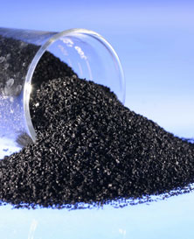
Activated Carbon

Slide 76
Process (Steam Activation)
Above 1100oC the reaction becomes diffusion controlled and therefore takes place on the outer surface of the charcoal resulting in loss of charcoal.
Below 900oC the reaction becomes too slow and is very uneconomical.
The temperature factor, in the process of activation is very important.
The reaction between steam and charcoal takes place at the internal surface area, creating more sites for adsorption.
The coconut shell charcoal is activated by reaction with steam at a temperature of 900oC -1100oC under controlled atmosphere in a rotary kiln.
Firstly the coconut shell is converted into shell charcoal by carbonization process which is usually carried out in mud-pits, brick kilns and metallic portable kilns.
The process of activation is carried out in two stages.

Slide 77
Project cost (9 tons/day)
Land (cost variable) | One acre.
Building 12000 sq.ft | Rs. 60 lakhs
Plant & Machinery | Rs. 300.00 lakhs
Preliminary & pre-operative expenses | Rs.30.00 lakhs
Electrification | Rs.40.00 lakhs
Working capital (Margin Money) | Rs 70.00 lakhs
Total | Rs. 440.00 lakhs
IRR | 24%

Slide 78
Training to Private Entrepreneurs by CDB, Institute of Technology, Vazhakulam, Kerala
Training Programme | Duration | Fees | No. of trainees in a batch
1. Training in processing of coconut based food products like coconut chips, biscuit, pickle, chutney powder) | 1 day | Rs. 250/- | 20
2. Processing of coconut based food products (chips, biscuit, pickle, spicy cookies, coconut ball) including food for trainees | 4 days | Rs. 2500/- | 20
3. Coconut vinegar (including food) | 2 days | Rs.2500/- | 20
4.Minimal processing of tender nut ( including food) | 1 day | Rs.250/- | 20
5.Processing of Neera based value added products (fruit jam, cookies, neera cake, jaggery, burfi, chocolates, laddu and honey) includes food and accommodation. | 6 days | Rs.5000/- | 20
6.Certificate courses in coconut processing (Including food) | 1 month | Rs.12000/- | 20
7.Neera Master technician training (including food and accommodation) | 14 days | With assistance | 20
8.Educational programmme for students (BSc, MSc, B Tech, M Tech, Food science and technology, food processing, food chemistry, food micro biology) | 1 month | Rs.5000/-

Slide 79
Processing units assisted under TMOC
in Andhra Pradesh
Sl. No. | Name of the Unit & Address | Capacity (Nuts/ day) | Products | Total Project Cost (Rs.) | Subsidy sanctioned (Rs.) | Subsidy released (Rs.)
1 | M/s.Sritara Agrotewch, Ongole,AP | 25000 | Coconut Processing Unit - VCO | 19150000 | 3966750 | 3966750
2 | M/s.Anu Coco Food Products Pvt.Ltd, Hyderabad | 25000 | Tender Coconut water | 38568000 | 4362500 | 4074000
3 | Smt. A Rukmini Devi, Mandal, (Via)Sivakodu, Andhra Pradesh | 1000 | Ball Copra | 1060000 | 265000 | 265000
4 | Shri. Maturi Narayana Murty, Rama Chandra Colony, Palakol. | 500000/ batch | Ball copra | 3300000 | 812500 | 812500
5 | M/s. Sree Agro Products Pvt. Ltd., W.G.Dist, AP | 40000 | Dessicated Coconut | 32893000 | 1091000 | 978500
6 | M/s.Sri Jayalakshmi, W.Godavari | 10000 | Tender Coconut water | 11500000 | 2600000 | 2340000
7 | Shri. Gokavarapu Venkata Ramana Murthy, Mnachavaram Panchayath, Ambajipeta E. Godavari Dist, Andhra Pradesh | 12000/ year | Ball copra (3000 nuts per batch ) | 1250000 | 216000 | 216000
8 | Sri Soubhagya Agro Foods & Minerals Pvt Ltd, Visakhapatnam | 10 T shells / day | Shell powder | 7683000 | 1652300 | 1198150
9 | Sree Konaseema Coconut Food Products, Ambajipet Mandal, E.G. Dist, AP | 12000 | Desiccated Coconut | 4400000 | 620000 | 557700
10 | Shri Appana Naga Venkateswara Rao, AVR & CO. – Copra Merchant, Ambajipetta, East Godavari A.P | 65000/ cycle | Ball copra | 2300000 | 325000 | 292500

Slide 80
11 | Shri. Pedamallu Venkateswara Rao, S/o. Rama Murthy, Pasarlapudilanka, Mamidikuduru Mandal,E. Godavari Dist, Andhra Pradesh | 1500000/yr | Ball copra | 1280000 | 320000 | 288000
12 | M/s.Rachamallu Carbons Pvt. Ltd. Banjara Hills, Hyderabad, A.P. | 8 MT A.C/day | Activated Carbon | 48430000 | 5000000 | 4500000
13 | Shri.Sushil Goyal, S/o. Shri.Jagadish Prasad, Rajasthan Coco Co., Coconut & Copra Merchants, Muktheswaram, Amalapuram Tk, E. G. Dist, Andhra Pradesh | 1000000/Year | Ball Copra | 1500000 | 312500 | 156250
14 | M/s. Sri Venkata Lakshmi Traders, Canal Road, Vedangi, Poduru Mandal, West Godavari Dist, Andhra Pradesh | 1000000/year | Ball Copra | 2887000 | 702500 | 702500
15 | Smt. Kasa Renuka Durga Devi, W/o.Shri.Satyanarayana, Aryapet Panchayat, Elamanchili Mandal, W.G. Dist, Andhra Pradesh | 400000/yr | Ball Copra | 2574000 | 643500 | 579150
16 | Shri. Kankipati Adinarayana,Allavarm, EG Dist. AP | 700000/yr | Ball Copra | 2000000 | 500000 | 250000
17 | S/Shri. Appana Venkata Raju & Appana Sudhakar Rao, Ambajipeta, E.G. District, AP | 600000/yr | Ball Copra | 3100000 | 775000 | 387500
18 | Shri. Pedamallu Brahmanandham, S/o. Suryanarayana Murty, Pasarlapudi Lanka, Mamidikuduru Mandal, EG Dist. | 1200000/yr | Ball Copra | 3600000 | 597500 | 298750
19 | Smt.Naga Satya Sai Saraswathi Hanumayamma Gade, W/o. G.Satyanarayana Murty, Ambajipeta, E.G.Dist, Ph- 08856-243074, 09440504507 E Mail – gnbsatish@gmail.com | 4 lakhs coconut / year | Ball Copra | 1950000 | 362500 | 181250

Slide 81
20 | Shri Pedamallu Venkata Ramanayya, S/o. Venkata Ratnam, Pasarlapudilanka, Mamidikuduru, Mandal, E.G.Dist, Andhra Pradesh | 4 lakhs coconut / year | Ball Copra | 1200000 | 300000 | 150000
21 | Smt. Bhavaraju Manorama, W/o. Suryaprakasa Rao, B.Doddavaram Post, Mamidikuduru Mandal, East Gadavari Dist. Mob No . 8374940226, Ph – 08862 239103 | 8.0 lakh coconuts/year | Ball Copra | 2530000 | 367000 | 183500
22 | Shri. Bonam Suryanarayana Murthy, Mamidikuduru Mandal, EG Dist, Andhra Pradesh Mob – 9849391953, 9491575919 | 12 lakhs/yr | Ball Copra | 3770000 | 567000 | 283500
 | Total |  |  | 196925000 | 26358550 | 22661500

Slide 82

Thank You…

